Slide 1
Graph
Algorithms
CZ2001 ALGORITHM
Ang Shu Hui
Bachhas Nikita
Kundu Koushani
Leonardo Irvin

Slide 2
Contents
Explanation of the Code
Empirical Analysis
Introduction to BFS
Time Complexity

Slide 3
Breadth-First Search
(BFS)
01

Slide 4
Problem
In our problem,

Slide 5
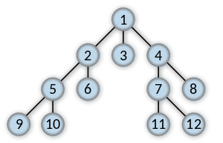
BFS
Search is carried out level by level (horizontally)
The numbers denote the order in which the nodes are searched

Slide 6
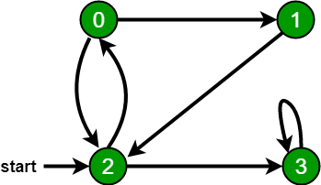
BFS
Here, we start traversal from vertex 2
On reaching vertex 0, we look for all adjacent vertices of it. 2 is also an adjacent vertex of 0.
Illustration of a BFS using the graph below
∴ A breadth first traversal of this graph is 2,0,3,1

Slide 7
02
Explanation of the Code

Slide 8
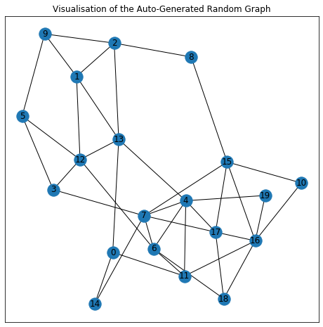
X
Traversing Algorithm
Hospital = [4, 12, 16, 17]
Initial node = 8
Condition = BFS in INCREASING order
Find top-2 nearest hospital from the initial node!

Slide 9
X
Traversing Algorithm
Hospital = [4, 12, 16, 17]
Initial node = 8
Condition = BFS in INCREASING order
Visited = [8]
Queue = [8]

Slide 10
X
X
Hospital = [4, 12, 16, 17]
Initial node = 8
Condition = BFS in INCREASING order
edges_dict[8] = [2, 15]
Visited = [8, 2]
Queue = [2]
Parent of node 2 is node 8

Slide 11
X
X
X
Hospital = [4, 12, 16, 17]
Initial node = 8
Condition = BFS in INCREASING order
edges_dict[8] = [2, 15]
Visited = [8, 2, 15]
Queue = [2, 15]
Parent of node 15 is node 8

Slide 12
X
X
X
Hospital = [4, 12, 16, 17]
Initial node = 8
Condition = BFS in INCREASING order
X
edges_dict[2] = [1, 9, 13]
Visited = [8, 2, 15, 1]
Queue = [15, 1]
Parent of node 1 is node 2

Slide 13
X
X
X
X
Hospital = [4, 12, 16, 17]
Initial node = 8
Condition = BFS in INCREASING order
X
edges_dict[2] = [1, 9, 13]
Visited = [8, 2, 15, 1, 9]
Queue = [15, 1, 9]
Parent of node 9 is node 2

Slide 14
X
X
X
X
X
Hospital = [4, 12, 16, 17]
Initial node = 8
Condition = BFS in INCREASING order
X
edges_dict[2] = [1, 9, 13]
Visited = [8, 2, 15, 1, 9, 13]
Queue = [15, 1, 9, 13]
Parent of node 13 is node 2

Slide 15
X
X
X
X
X
Hospital = [4, 12, 16, 17]
Initial node = 8
Condition = BFS in INCREASING order
X
X
edges_dict[15] = [7, 10, 16, 17]
Visited = [8, 2, 15, 1, 9, 13, 7]
Queue = [1, 9, 13, 7]
Parent of node 7 is node 15

Slide 16
X
X
X
X
X
Hospital = [4, 12, 16, 17]
Initial node = 8
Condition = BFS in INCREASING order
X
X
X
edges_dict[15] = [7, 10, 16, 17]
Visited = [8, 2, 15, 1, 9, 13, 7, 10]
Queue = [1, 9, 13, 7, 10]
Parent of node 10 is node 15

Slide 17
X
X
X
X
X
X
Hospital = [4, 12, 16, 17]
Initial node = 8
Condition = BFS in INCREASING order
X
X
X
X
edges_dict[15] = [7, 10, 16, 17]
Visited = [8, 2, 15, 1, 9, 13, 7, 10, 16]
Queue = [1, 9, 13, 7, 10, 16]
Parent of node 16 is node 15
IT IS A HOSPITAL!

Slide 18
X
X
X
X
X
Hospital = [4, 12, 16, 17]
Initial node = 8
Condition = BFS in INCREASING order
X
X
X
X
edges_dict[15] = [7, 10, 16, 17]
X
Visited = [8, 2, 15, 1, 9, 13, 7, 10, 16, 17]
Queue = [1, 9, 13, 7, 10, 16, 17]
Parent of node 16 is node 15
IT IS A HOSPITAL!

Slide 19
X
Write-back Algorithm
Hospital = [4, 12, 16, 17]
Initial node = 8
Condition = BFS in INCREASING order
Parent node of node 16 is node 15.
Count = 1

Slide 20
X
Write-back Algorithm
Hospital = [4, 12, 16, 17]
Initial node = 8
Condition = BFS in INCREASING order
Parent node of node 15 is node 8.
Count = 2

Slide 21
X
Write-back Algorithm
Hospital = [4, 12, 16, 17]
Initial node = 8
Condition = BFS in INCREASING order
Path: 8 -> 15 -> 16
Distance: 2 nodes

Slide 22
X
Write-back Algorithm
Hospital = [4, 12, 16, 17]
Initial node = 8
Condition = BFS in INCREASING order
Parent node of node 17 is node 15.
Count = 1

Slide 23
X
Write-back Algorithm
Hospital = [4, 12, 16, 17]
Initial node = 8
Condition = BFS in INCREASING order
Parent node of node 15 is node 18.
Count = 2

Slide 24
X
Write-back Algorithm
Hospital = [4, 12, 16, 17]
Initial node = 8
Condition = BFS in INCREASING order
Path: 8 -> 15 -> 17
Distance: 2 nodes

Slide 25
X
Write-back Algorithm
Hospital = [4, 12, 16, 17]
Initial node = 8
Condition = BFS in INCREASING order
Solution:
Top-2 nearest hospital are,
8 -> 15 -> 16, distance is 2 nodes
8 -> 15 -> 17, distance is 2 nodes

Slide 26
03
Time Complexity

Slide 27
Pre-processing Stage
Edge dictionary
Time complexity = 1 + 2m
= O(m)
Hospital flag array
Time complexity = 1 + h
= O(h)

Slide 28
Searching Stage - Part(a)
Best-case time complexity = O(1)
The node itself is the hospital
The node is the first element in the hospital_list array

Slide 29
Searching Stage - Part(a)
Worst-case time complexity = O(hn+m)
Each node will be queued and dequeued once -> O(n)
For every node, the algorithm will check if it is a hospital -> O(hn)
Each edge will be processed to edge_dict -> O(m)

Slide 30
Searching Stage - Part(b)
Worst-case time complexity = O(n+m)
hospital_flag array is implemented
O(h) + O(n+m) is less significant than O(hn+m)

Slide 31
Searching Stage - Part(c) & (d)
Part (c) - k = 2
The value of k is insignificant
Time complexity is similar to that of part(b)
Part (d) - k = 1, 2, 3, … h
Time complexity = O(kn+km)
The algorithm needs to search through the graph for top k hospitals

Slide 32
Post-processing Stage
visit_dict:
best-case time complexity = O(1)
First node is the parent node
Second node is the hospital node
Only 1 primitive operation is carried out

Slide 33
Post-processing Stage
visit_dict:
worst-case time complexity = O(n-h)
First node is the parent node
The nearest hospital node is the last node in the graph

Slide 34
Empirical Analysis
04

Slide 35
Auto-Generated
Real-Roal Network

Slide 36
Time Taken
 | Number of Nodes, Number of Hospital Nodes | Pre-Processing Time | Part (a) | Part (b) | Part (c) | Part (d) (k=3)
Auto-Generated Random Graph | Nodes = 20 Hospital Nodes = 3 | 998 µs | 2 ms | 1.99 ms | 1.99 ms | 3.66 s
 | Nodes = 200 Hospital Nodes = 5 | 1.99 ms | 15 ms | 18.9 ms | 27.9 ms | 4.72 s
 | Nodes = 5000 Hospital Nodes = 10 | 1.24 s | 1min 3s | 1min 3s | 1min 31s | 2min 28s
Real Road Network | (Road Network - CA) Nodes = 1965206 Hospital Nodes = 150
 | (Road Network - PA) Nodes = 1088092 Hospital Nodes = 150
 | (Road Network - TX) Nodes = 1088092 Hospital Nodes = 150

Slide 37
What affects the time complexity?
Total Number of Nodes = n
Number of edges = m
Number of hospital nodes = h
Nearest K hospitals = k

Slide 38
Auto-Generated Vs Real Network
Use Auto-generated Random Graph instead of the Real Road Network
How is the Random Graph Auto-generated?
using the Erdős–Rényi model

Slide 39
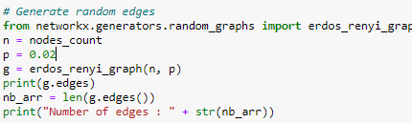
Auto-Generated Model
m is auto generated based on n and p
p is set at 0.02

Slide 40
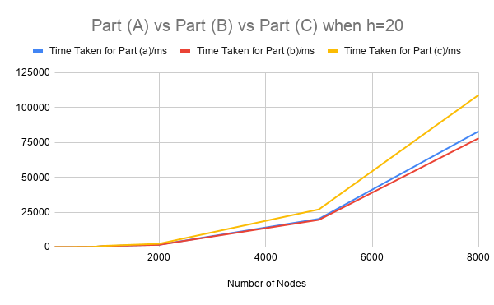
Effect of n on Time Taken
Notes:
Over here h is kept constant at 20. It can be seen in the graph that the time complexity to carry out all three parts is relatively the same when the total number of nodes is the smallest. However, the time taken for part(c) rapidly increases, rising much faster than that of part (a) and part (b). This supports the theory as the time complexity for part (c) is O(kh+km) in the worst case scenario, while the time for part(c) is rising faster, where we have to find the nearest 2 hospitals, than for part (a) and part (b). Comparatively, as n increases, time taken for part(a) rises faster than the time taken for part(b) as n increases. This supports the theory as the worst case time complexity for part (a) is O(hn+m) while the worst case time complexity for part (b) is O(n+m). Hence, regardless of h, time taken for part (a) will always be higher than time taken for part (b). As the number of hospital nodes increase, the time taken for all three parts is relatively the same.

Slide 41
Empirical Findings for Part (C)
Time taken for (c) faster than that of (a) & (b)
THEORY == EMPIRICAL FINDINGS!
Worst Case Time complexity for (c) = (d) = O(kh+km)
As k=2 in part (c), the time taken for c increase significantly faster than (a) & (b)
Notes:
the time taken for part(c) rapidly increases, rising much faster than that of part (a) and part (b). This supports the theory as the time complexity for part (c) is O(kh+km) in the worst case scenario, while the time for part(c) is rising faster, where we have to find the nearest 2 hospitals, than for part (a) and part (b). Comparatively, as n increases, time taken for part(a) rises faster than the time taken for part(b) as n increases. This supports the theory as the worst case time complexity for part (a) is O(hn+m) while the worst case time complexity for part (b) is O(n+m). Hence, regardless of h, time taken for part (a) will always be higher than time taken for part (b)

Slide 42
Empirical Findings for Part (A) & (B)
Time taken for (a) faster than that of (b)
THEORY == EMPIRICAL FINDINGS!
Worst Case Time complexity for (a) = O(hn+m)
Worst Case Time complexity for (b) = O(n+m)
Notes:
It can be seen in the graph that the time complexity to carry out all three parts is relatively the same when the total number of nodes is the smallest. However, the time taken for part(c) rapidly increases, rising much faster than that of part (a) and part (b). This supports the theory as the time complexity for part (c) is O(kh+km) in the worst case scenario, while the time for part(c) is rising faster, where we have to find the nearest 2 hospitals, than for part (a) and part (b). Comparatively, as n increases, time taken for part(a) rises faster than the time taken for part(b) as n increases. This supports the theory as the worst case time complexity for part (a) is O(hn+m) while the worst case time complexity for part (b) is O(n+m). Hence, regardless of h, time taken for part (a) will always be higher than time taken for part (b)

Slide 43
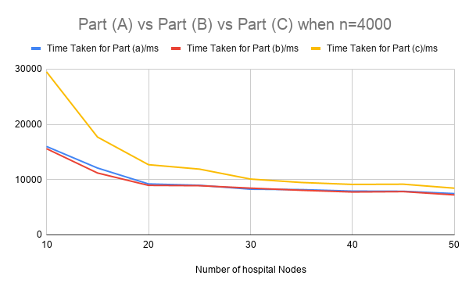
Effect of h on Time Taken
Notes:
Over here, n is kept constant at 4000 nodes. It can be seen in the graph that the time taken for part (b) decreases at a faster rate than that for part (a). This supports the theory as the worst case time complexity for part (a) is O(hn+m) while the worst case time complexity for part (b) is O(n+m). Since the worst case time complexity is independent of h, only the number of nodes and number of edges between a particular node and a particular hospital will affect part (b)’s time taken. Time taken for part (c) decreases at much slower rate than part (a) and part (b), which also supports theory, as the worst case time complexity for part (c) is O(kh+km), which means that the time taken to carry out part (c) is affected by k, which in this part (c) is 2. As the number of hospital nodes increase, the time taken for all three parts is relatively the same.

Slide 44
Empirical Findings for Part (C)
Time taken for (c) faster than that of (a) & (b)
THEORY == EMPIRICAL FINDINGS!
Worst Case Time complexity for (c) = (d) = O(kh+km)
As k=2 in part (c), the time taken for c decrease significantly slower than in part (a) & part (b)
Notes:
Time taken for part (c) decreases at much slower rate than part (a) and part (b), which also supports theory, as the worst case time complexity for part (c) is O(kh+km), which means that the time taken to carry out part (c) is affected by k, which in this part (c) is 2.

Slide 45
Empirical Findings for Part (A) & (B)
Time taken for (b) faster than that of (a)
THEORY == EMPIRICAL FINDINGS!
Worst Case Time complexity for (a) = O(hn+m)
Worst Case Time complexity for (b) = O(n+m)
Notes:
It can be seen in the graph that the time taken for part (b) decreases at a faster rate than that for part (a). This supports the theory as the worst case time complexity for part (a) is O(hn+m) while the worst case time complexity for part (b) is O(n+m). Since the worst case time complexity is independent of h, only the number of nodes and number of edges between a particular node and a particular hospital will affect part (b)’s time taken. As the number of hospital nodes increase, the time taken for all three parts is relatively the same.

Slide 46
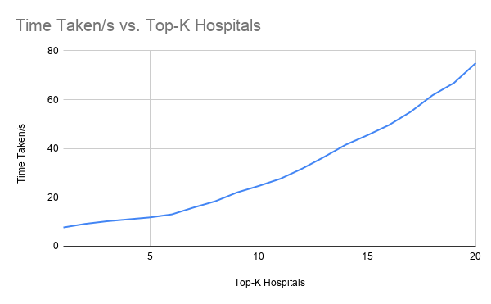
Effect of k on Time Taken
Notes:
It can be seen in the graph that the time taken to carry out part (d) increases exponentially as the number of k increases. This supports theory as well as the worst case time complexity for part (d) is O(kh+km). As k rises, the time taken to carry out part(d) will significantly increase each time.

Slide 47
Empirical Findings for Part (D)
Time taken for (d) exponentially
THEORY == EMPIRICAL FINDINGS!
Worst Case Time complexity for (c) = (d) = O(kh+km)
As k=1,2,3,4... , the time taken for (d) significantly increases each time
Notes:
It can be seen in the graph that the time taken to carry out part (d) increases exponentially as the number of k increases. This supports theory as well as the worst case time complexity for part (d) is O(kh+km). As k rises, the time taken to carry out part(d) will significantly increase each time.

Slide 48
Conclusion

Slide 49
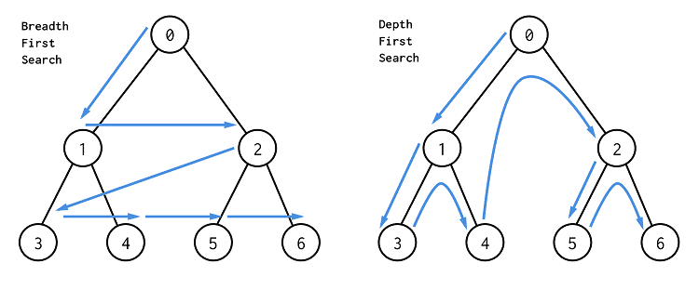
Conclusion

Slide 50
Thanks

Slide 51
Any Questions?

Slide 52
References
Photos
Vectors
Hands
Ethnic woman
Boy smiling
Business
Different people
Multiracial
Happy-people

